Slide 1




Distributed Dynamic Diversity Databases for Life (4D4Life)
Second Project Meeting
Plenary, February 17th 2010
Frank Bisby
University of Reading
f.a.bisby@reading.ac.uk

Slide 2



Who we are:
4D4Life builds on the
Species 2000 & IT IS Catalogue of Life:
- an existing EC infrastructure established in FP 5
- already with substantial usage
- and with extensive distributed supply networks
4D4Life is led from the Species 2000 Secretariat in Reading, by Frank Bisby (Co-ordinator) and Yuri Roskov (Exec. Editor).
38 partners with 6 Workpackage leaders: Sara Oldfield (BGCI), Thierry Bourgoin (MNHN Paris), Jiri Kvacek (Prague), Peter Schalk (ETI), Richard White Cardiff Univ.)
The Catalogue of Life provides a global reference catalogue, currently at 65% of all known species of plants, animals, fungi
and micro-organisms (1.25 million species) .

Slide 3
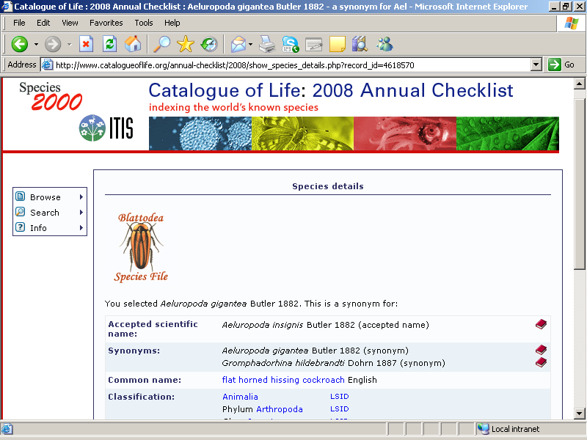
Catalogue of Life
taxonomic backbone services to users worldwide
GBIF
EoL
CBOL
IUCN?
BHL-E
EBI/GenBank
Global portals
Individual users:
40M hits per year;
40,000 unique users per month;
3,500 CDs per year to 80 countries
National Portals:
approx. 40
Catalogue of Life: distributed model
Global index to all known species on Earth (65% coverage so far)
Inventory of all Life, plus Taxonomic Hierarchy of all groups.
Assembled from 66 reviewed authoritative taxonomic databases worldwide

Slide 4
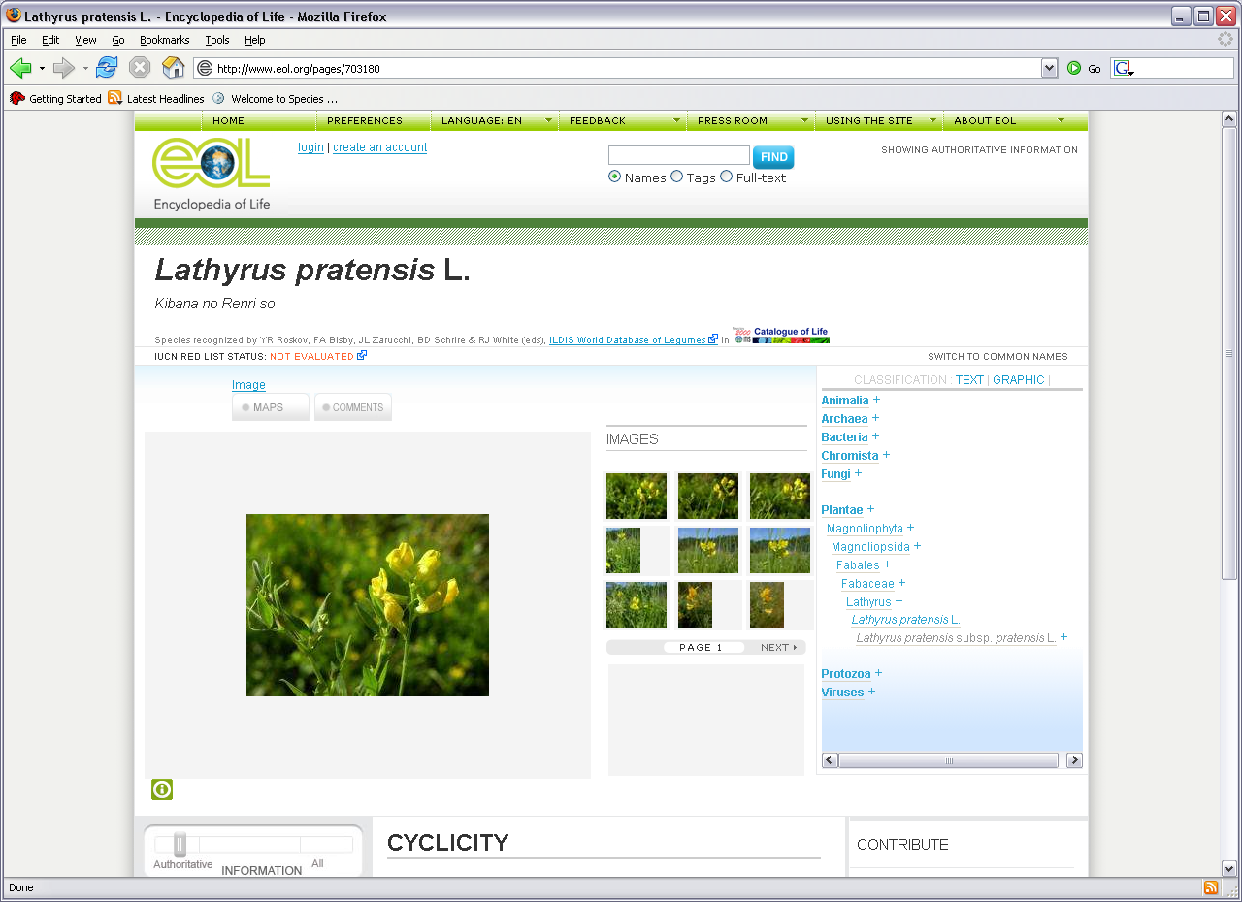
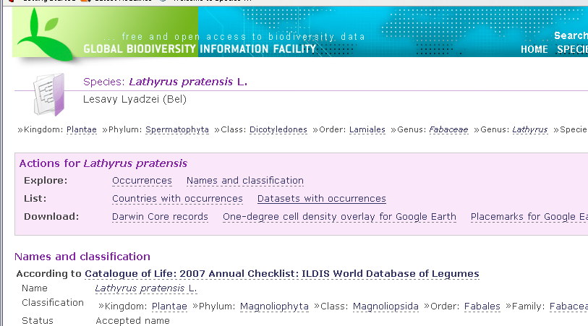

Slide 5
4D4Life: Distributed Dynamic Diversity Databases for Life
4D4Life Project (2009 – 2012)
is to build a state-of-the-art e-infrastructure that:
facilitates structured information exchange
within the CoL networks,
synthesises a globally significant Catalogue of Life
resource for science
disseminates this in an array of modern and
improved web-services and products
and leads to a sustainable future.

Slide 6
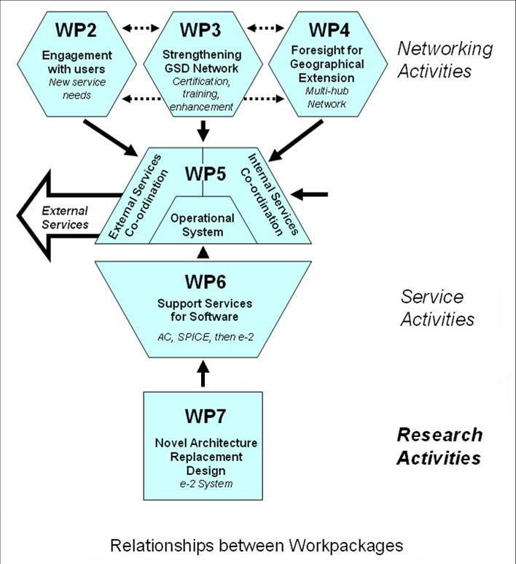

Slide 7


Networking Workpackages
WP 2
Engagement with scientific users and partners
Sara Oldfield, Botanic Gardens Conservation International
WP 3
Strengthening the Global Species Database Network
Thierry Bourgoin, MNHN, Paris.
WP 4
Foresight Study for geographical extension
Jiri Kvacek, Narodni Museum, Prague

Slide 8
Services Workpackages
WP 5
Scientific Services of the Catalogue of Life
Yuri Roskov University of Reading
WP 6
Software Support Services
Peter Schalk, ETI Informatics, Amsterdam
Research & Development Workpackage
WP 7
New Service-based Architecture
Richard White (& Alex Hardisty), Cardiff University

Slide 9
Progress so far:
Strong progress with early tasks on improvements to current software, interfaces, and integration of the two main workflows (WP 5 & 6).
Work on gathering suggestions (a huge list!) and user priorities for the new array of electronic and other services. Consultations world-wide (WP 2)
First and second meetings of Management Committee, Design Team and Services Team.
Excellent Opening Meeting of all 38 partners, including WP 4 Workshop (global partners), and WP 3 Workshop (supplier databases).
Annual Checklists 2009 and 2010 released on time (WP5 & WP6).

Slide 10
Next steps:
2010 – 2011 is the central year of the project when all tasks should be going ahead vigorously.
March 17/18 is the ‘Triage’ meeting at which we make decisions about new services to implement.
2010 – 2011 is the year for each GSD to undertake its two ‘pilot project’ tasks as setps towards compliance with Sp2000 standards.
2010 – 2011 is the year for prototyping the new e-2 service based architecture (WP7)
2010 – 2011 is the year for designing the Global Multi-hub Network (WP4)
2010 – 2011 is the year for unification of the Annual Checklist and Dynamic Checklst workflows (WP5 & WP6).

Slide 11
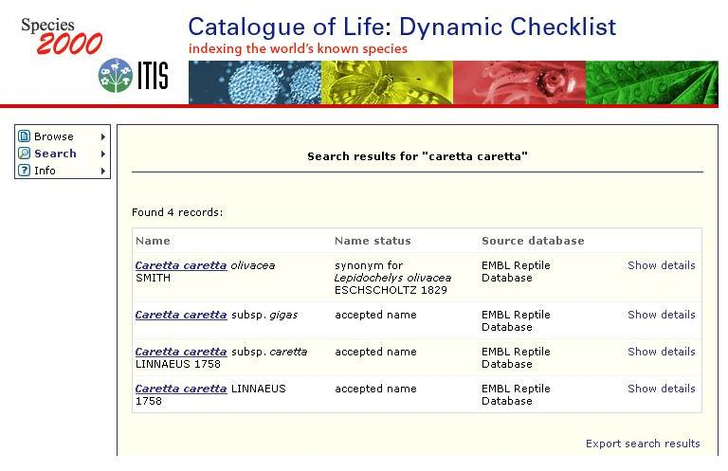
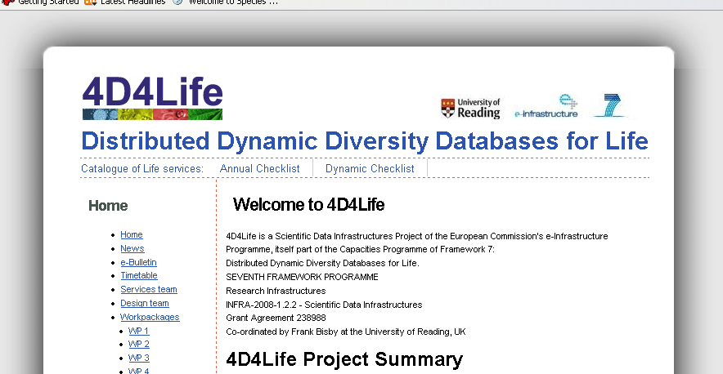
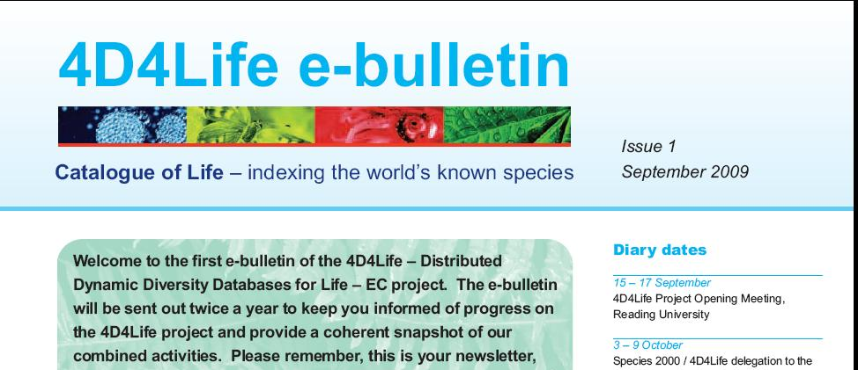
Reaching end users and partners

